Slide 2
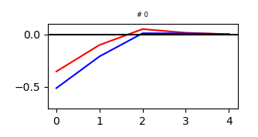
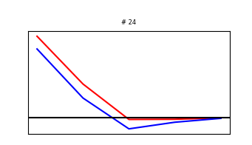
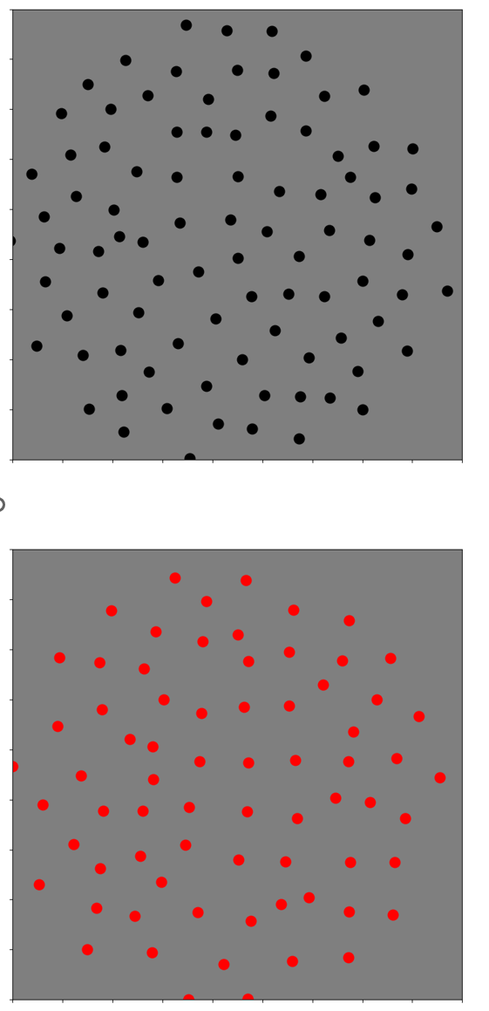
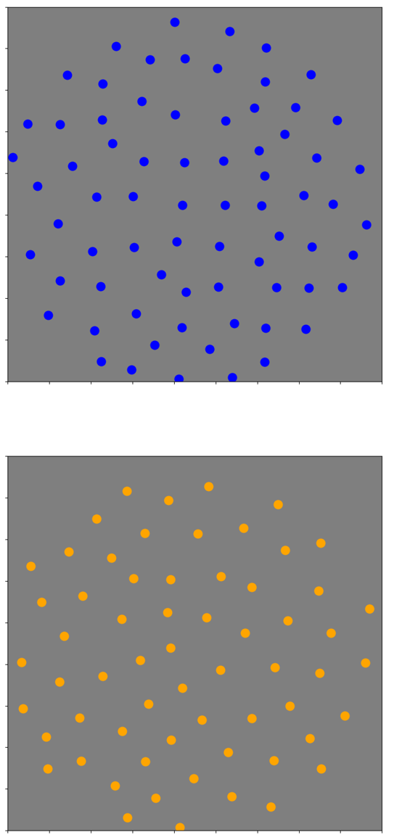
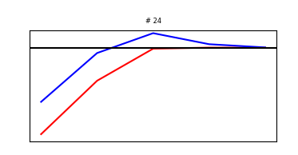
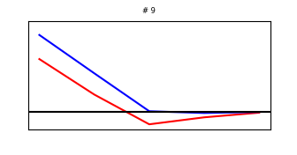

Slide 3
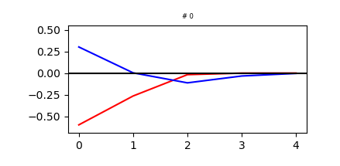
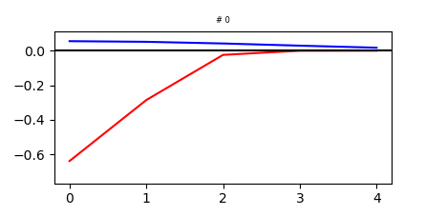
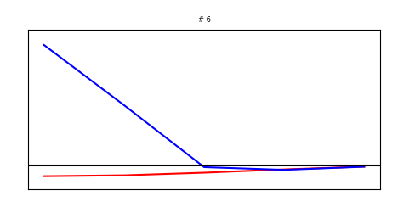
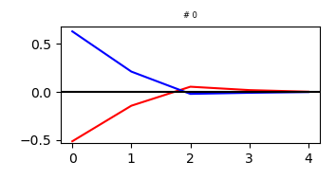
Effect of reversing weaker channel in last 2 mosaics
Manipulation
Training
66%
50%

Slide 4
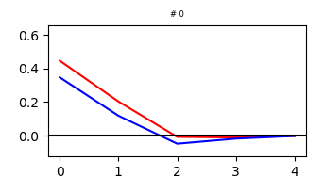
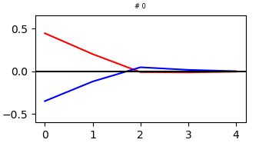
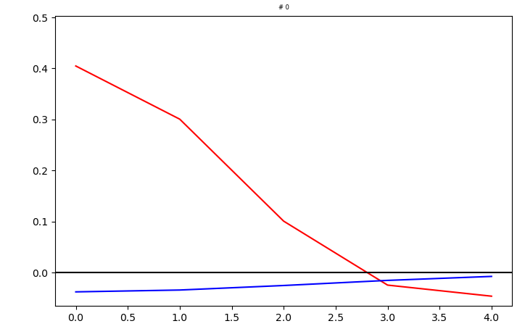
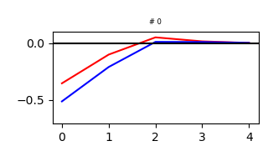
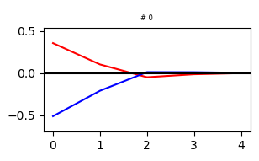
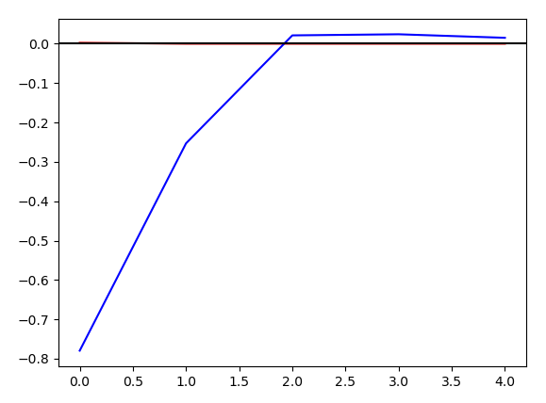
Effect of reversing weaker channel in first 2 mosaics
Manipulation
Training
11%
2.4%

Slide 5
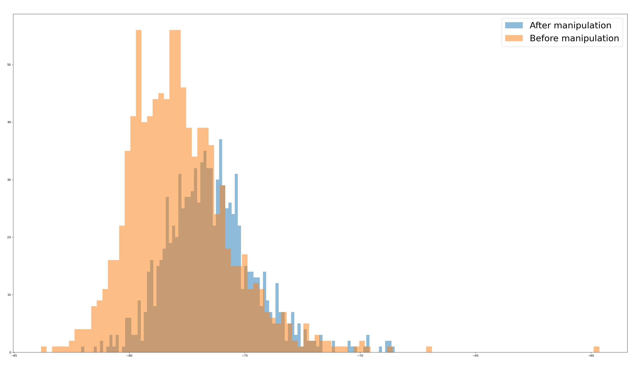
Effect on mutual information

Slide 6
Why does this asymmetry occur?
Let’s look at the statistics of natural images

Slide 7
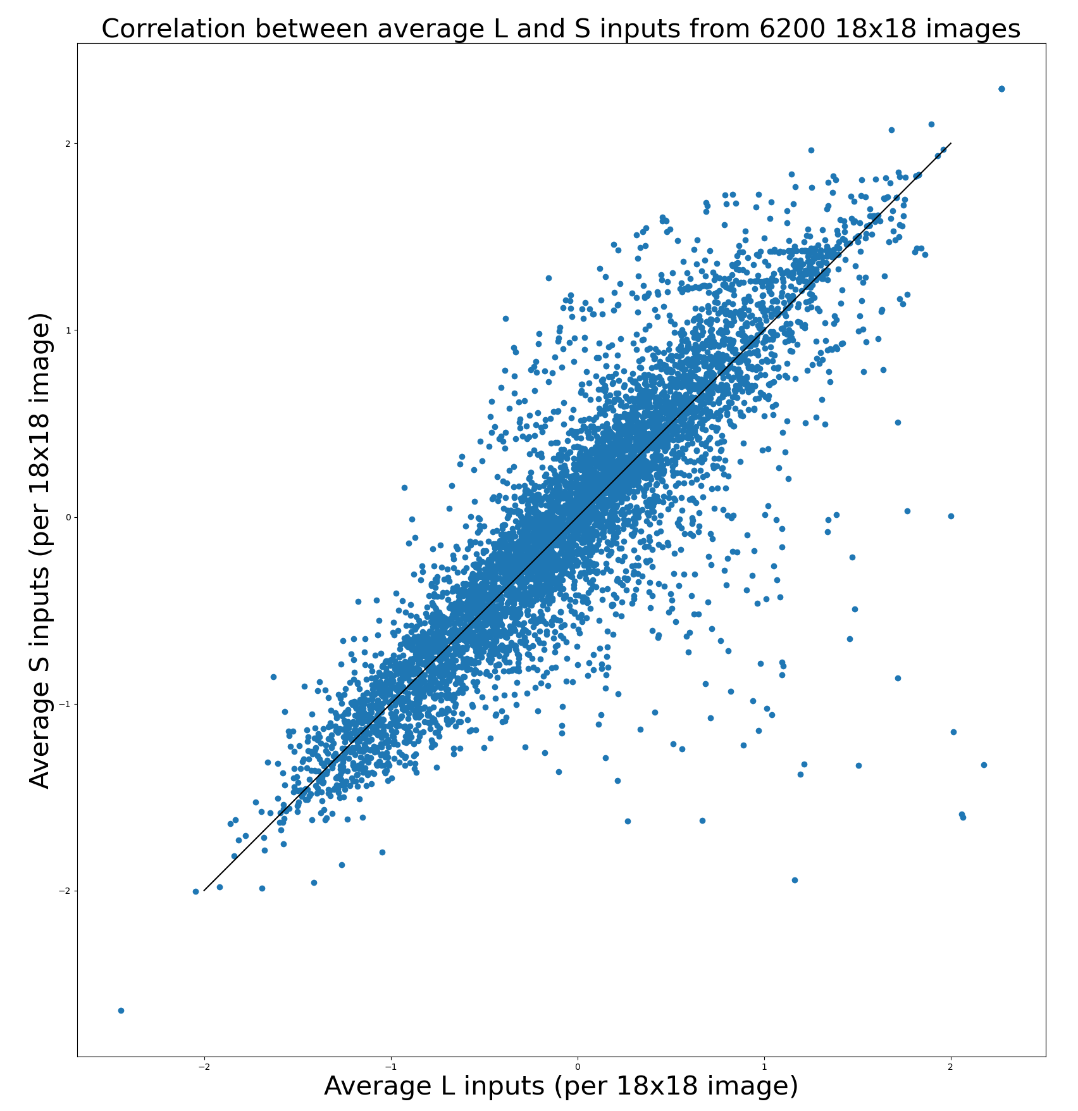

Slide 8
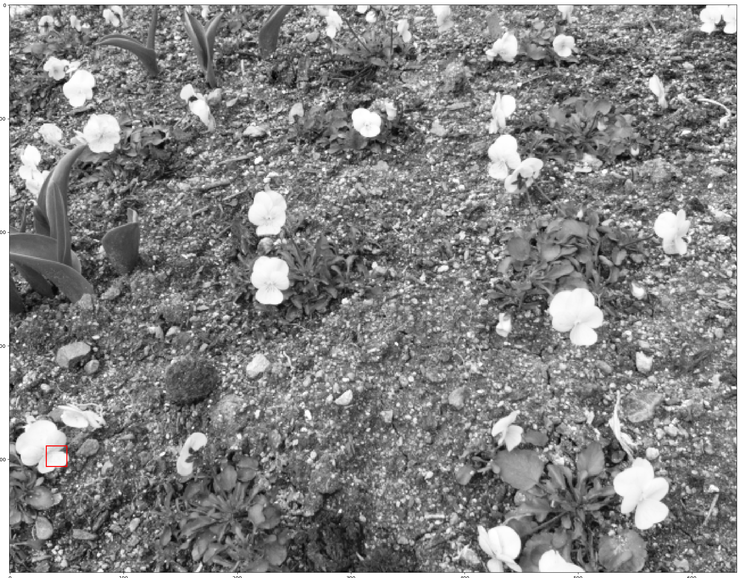

Slide 9
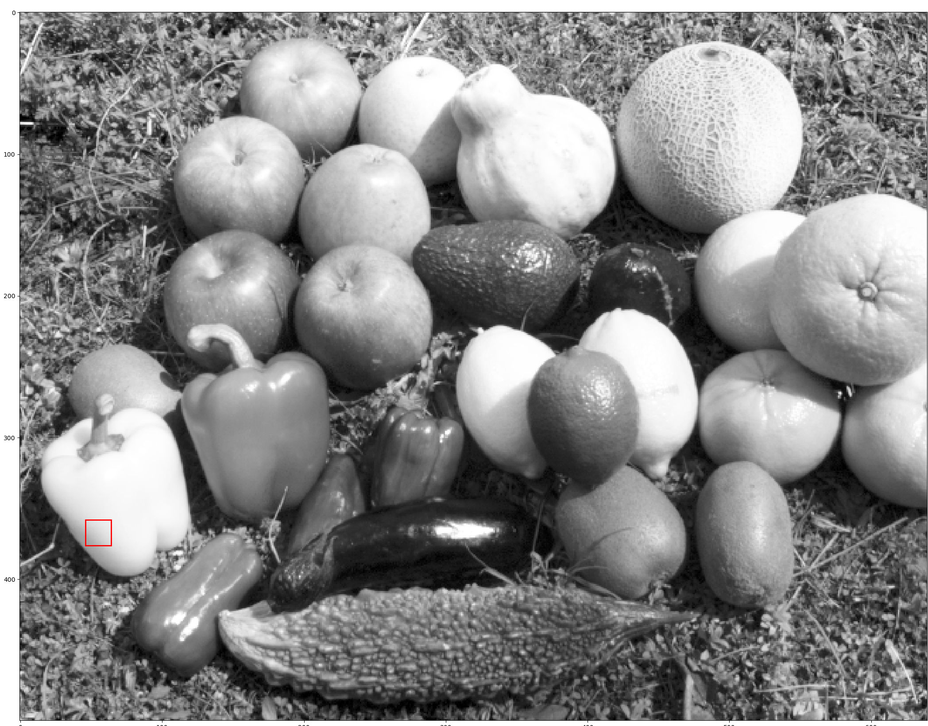

Slide 10
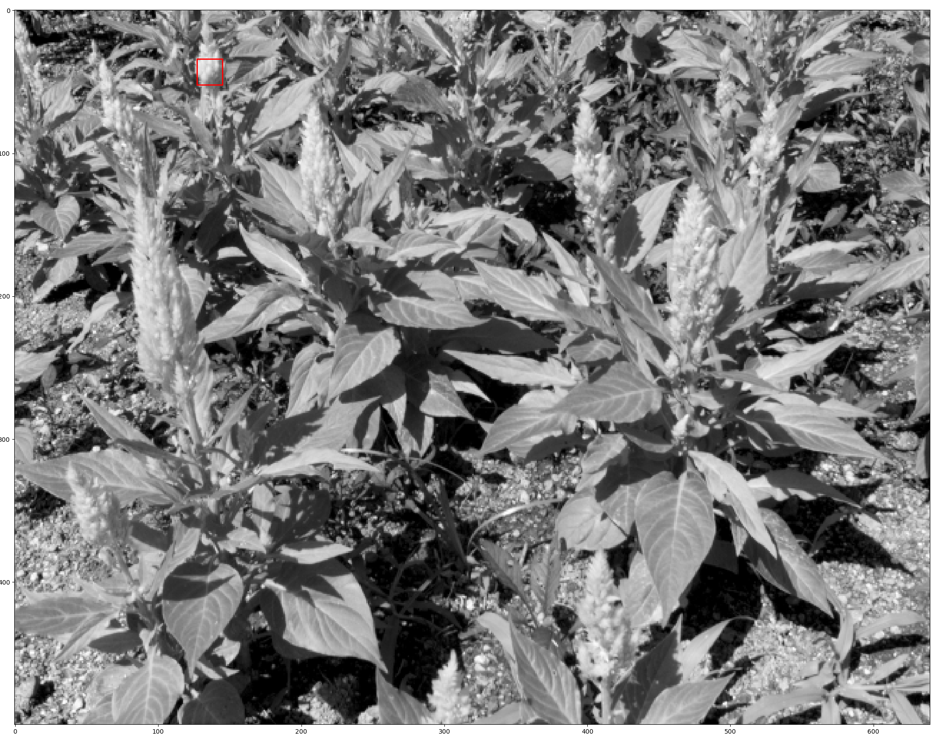

Slide 11
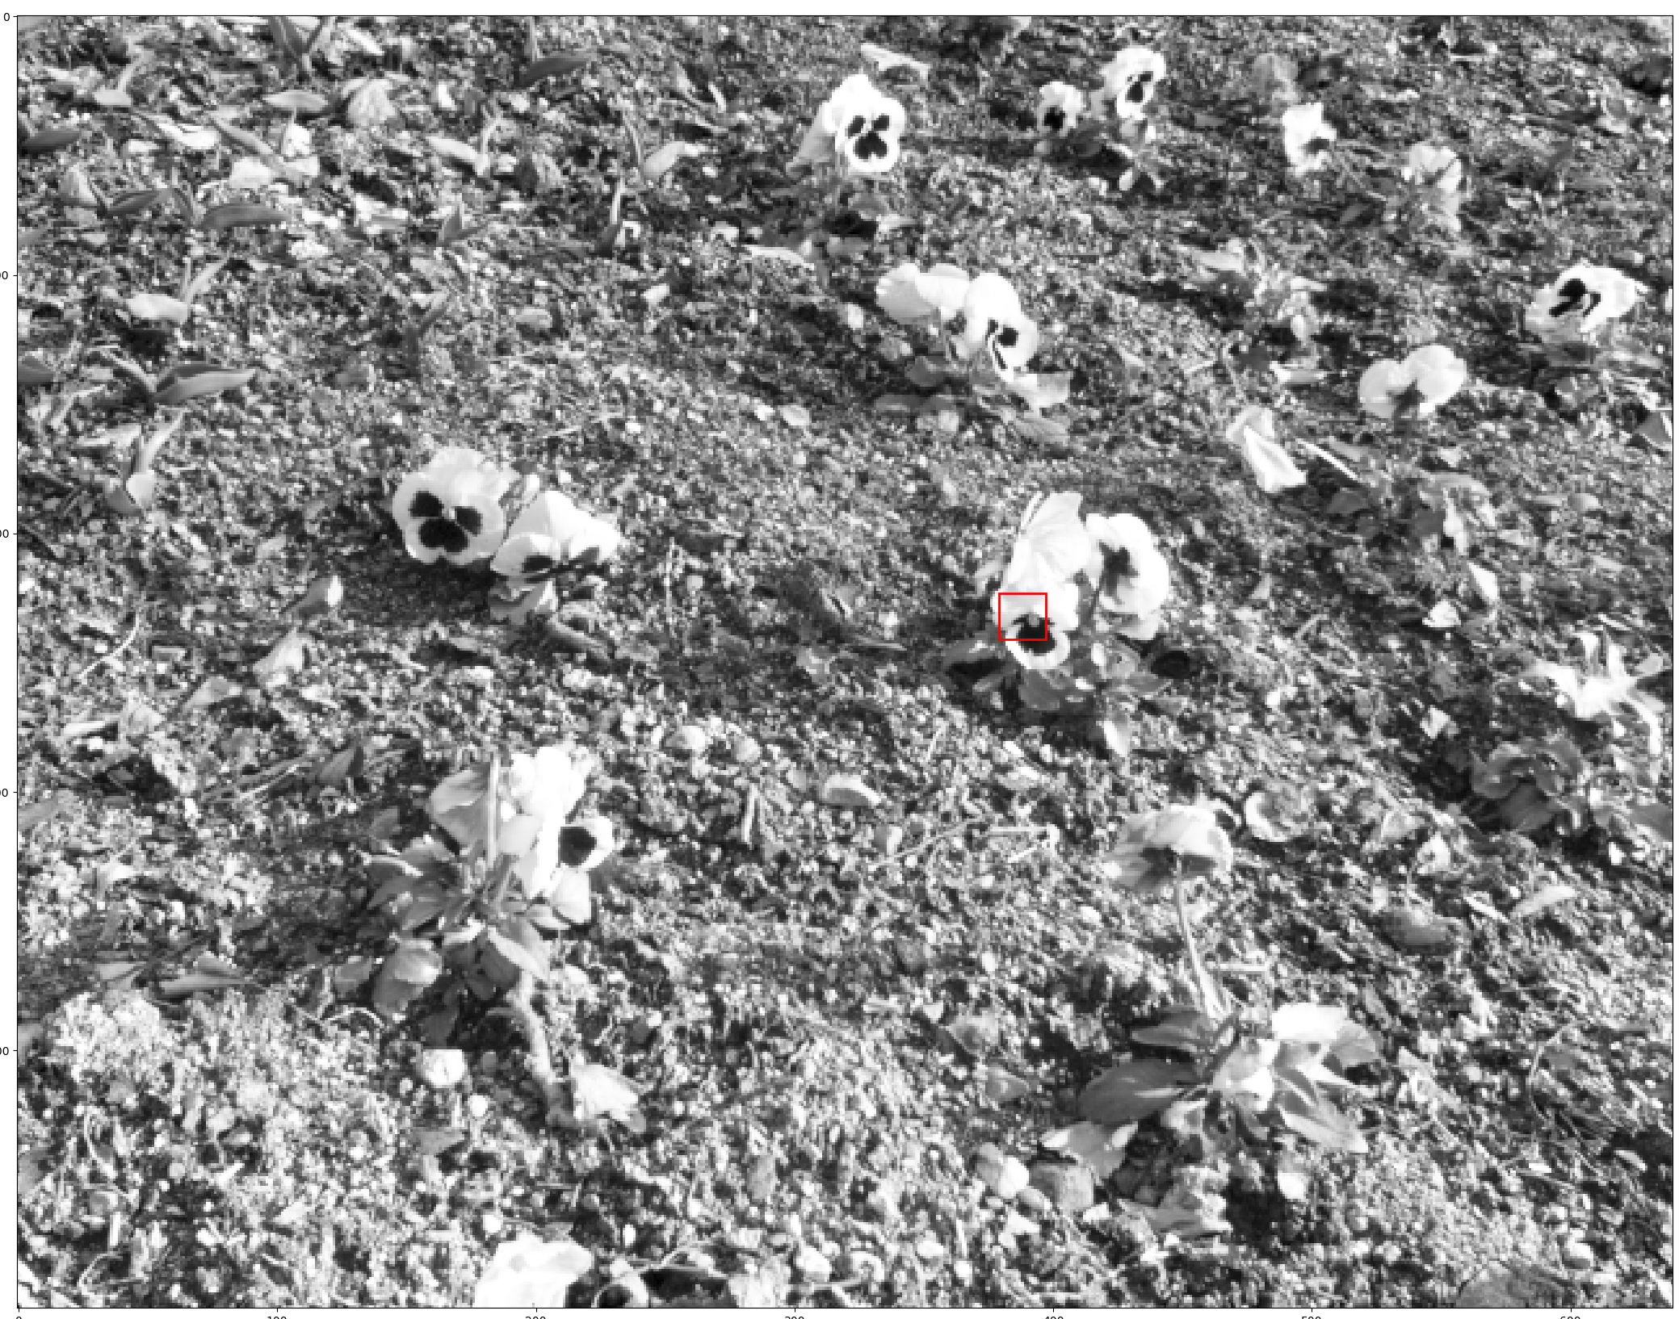

Slide 12
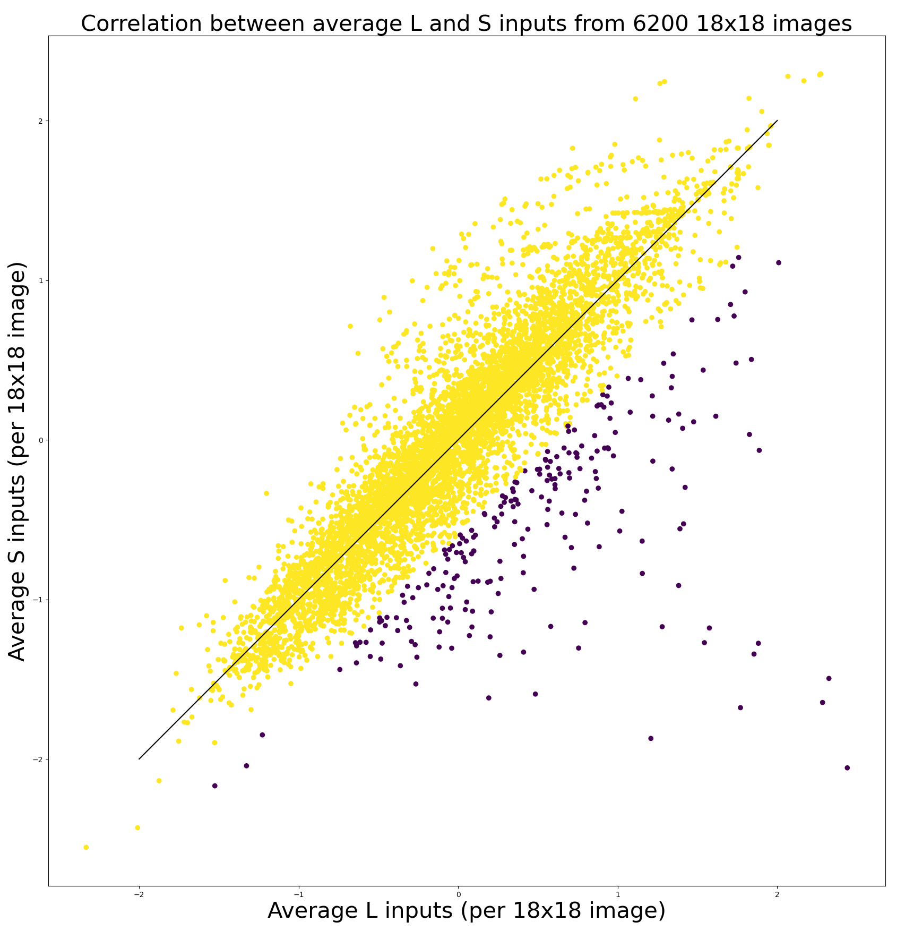
Removing images with strong +L – S bias
Remove 3.35% of images
Experiment1:
Try to get -L and +S clusters
Experiment 2:
Try to get +L and –S clusters

Slide 13
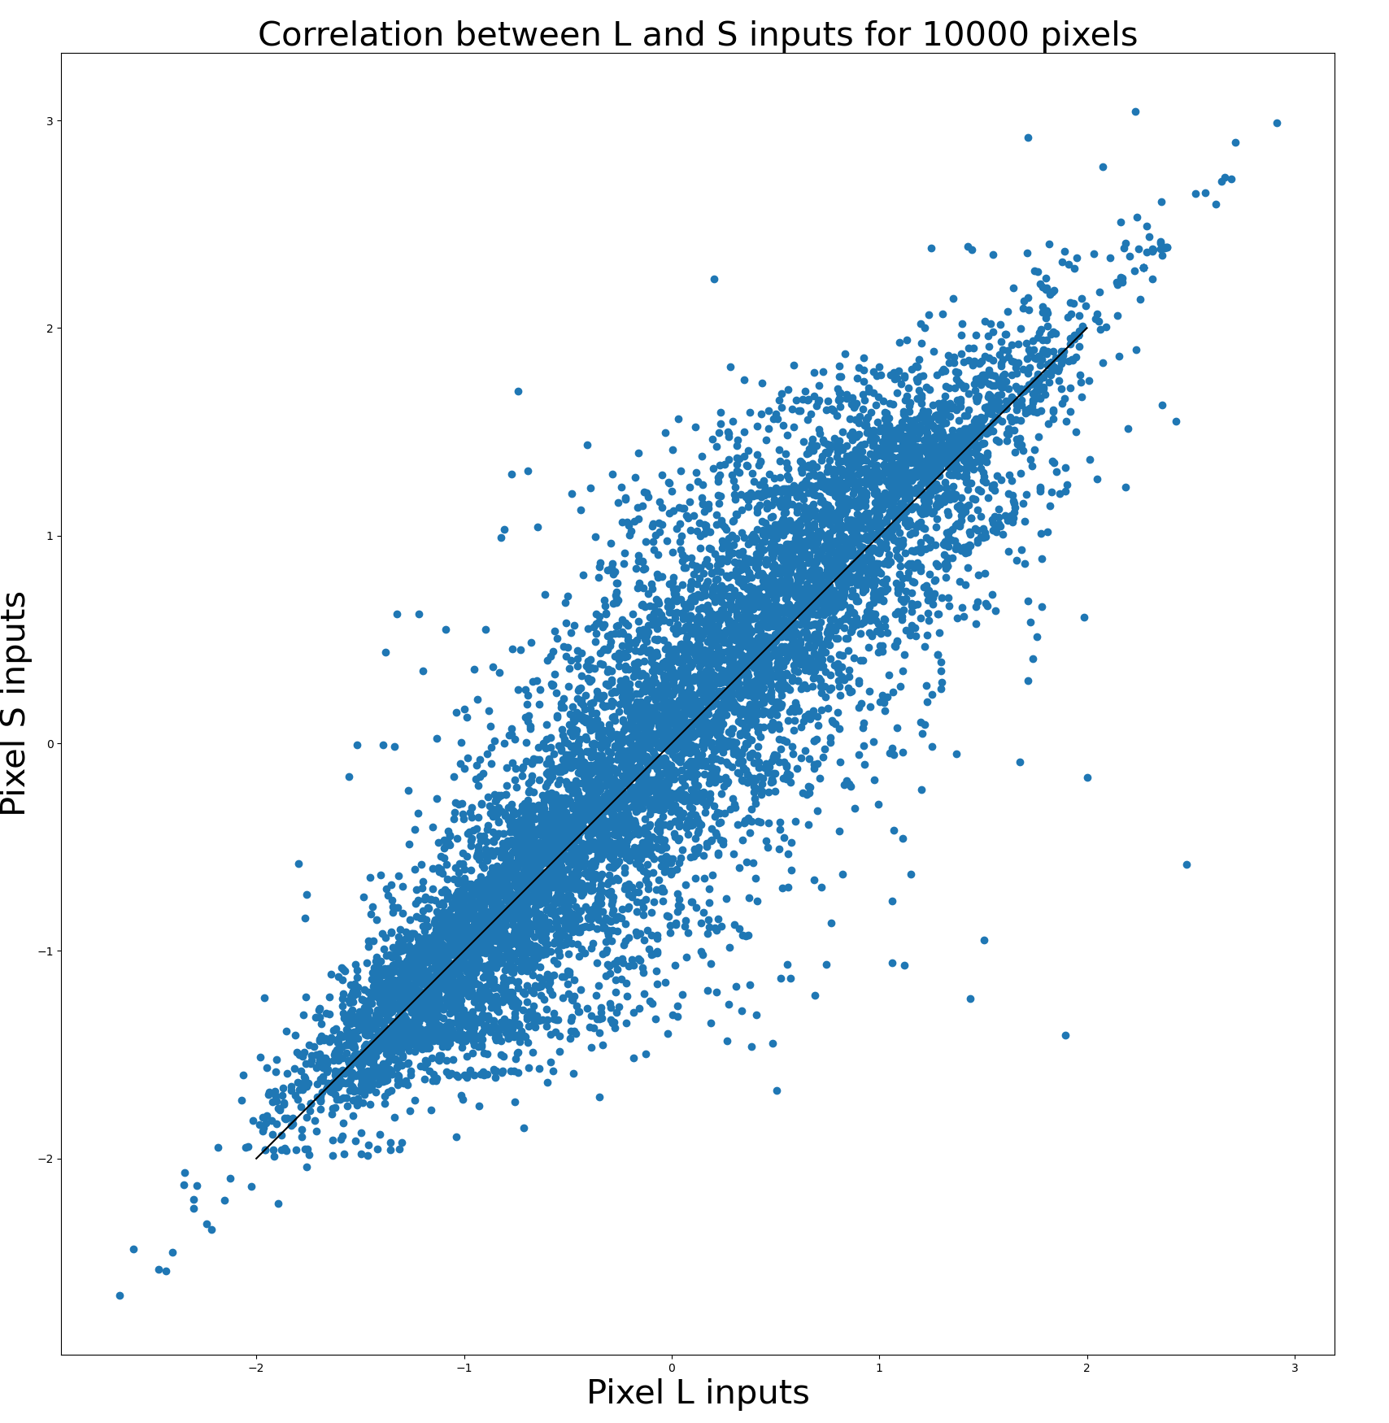
Hypothesis 1: L and S pixel distribution after removing 3% of images

Slide 14
The number of +S neurons drops significantly
Original images
ON: 112
OFF: 105
L OFF: 48
S ON: 35
After removing 3%
ON: 122
OFF: 107
L OFF: 48
S ON: 23

Slide 15
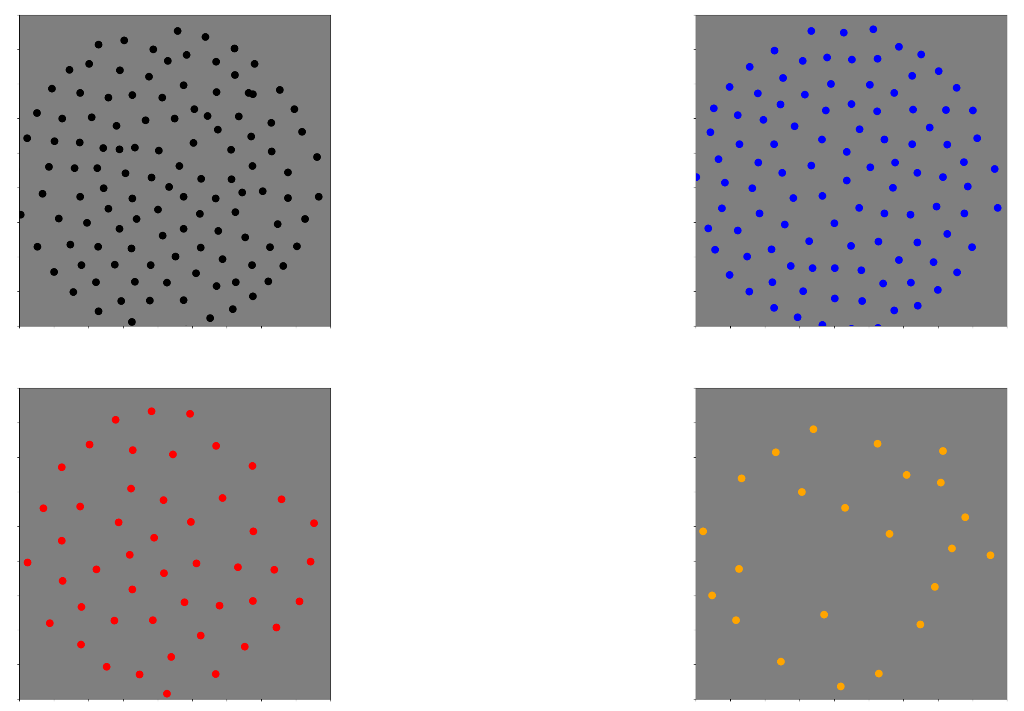
-L and +S mosaics

